Slide 1
WEB DEVELOPMENT & DESIGN FOUNDATIONS WITH HTML5
7TH EDITION
Chapter 2
Key Concepts
Copyright © Terry Felke-Morris
Notes:
Chapter 2

Slide 2
LEARNING OUTCOMES
In this chapter, you will learn how to ...
  Describe HTML, XHTML, and HTML5
  Identify the markup language in a web page document
  Use the html, head, body, title, and meta elements to code a template for a web page
  Configure the body of a web page with headings, paragraphs, line breaks, divs, lists, and blockquotes
  Configure text with phrase elements
  Configure a web page using new HTML5 header, nav, main, and footer elements
  Configure special characters
  Use the anchor element to link from page to page
  Create absolute, relative, and e-mail hyperlinks
  Code, save, and display a web page document
  Test a web page document for valid syntax
Notes:
Chapter 2

Slide 3
WHAT IS HTML?
HTML:
The set of markup symbols or codes placed in a file intended for display on a Web browser page.
The World Wide Web Consortium (http://w3c.org) sets the standards for HTML and its related languages.
Notes:
Chapter 2

Slide 4
HTML ELEMENTS
Each markup code represents an HTML element .
Each element has a purpose.
Most elements are coded as a pair of tags:
an opening tag and a closing tag.
Tags are enclosed in angle brackets, "<" and ">" symbols.
Notes:
Chapter 2

Slide 5

WHAT IS HTML5 ?
Newest draft version of HTML/XHTML
Supported by modern browsers
  Safari, Google Chrome, Firefox, Internet Explorer 9
Intended to be backwards compatible
Adds new elements
Adds new functionality
  Edit form data
  Native video and audio
  And more!
Source: W3C http://www.w3.org/html/logo/

Slide 6
DOCUMENT TYPE DEFINITION
Document Type Definition (DTD)
  doctype statement
  identifies the version of HTML contained in your document.
  placed at the top of a web page document

Slide 7
DTD EXAMPLES
XHTML 1.0 Transitional DTD
<!DOCTYPE html PUBLIC "-//W3C//DTD XHTML 1.0 Transitional//EN"
http://www.w3.org/TR/xhtml1/DTD/xhtml1-transitional.dtd>
HTML5 DTD
<!DOCTYPE html>
Notes:
Chapter 2

Slide 8
EXAMPLE HTML5 WEB PAGE
<!DOCTYPE html>
<html lang="en">
<head>
<title>Page Title Goes Here</title>
<meta charset="utf-8">
</head>
<body>
... body text and more HTML5 tags go here ...
</body>
</html>
Notes:
Chapter 2

Slide 9
HEAD & BODY SECTIONS
Head Section
Contains information that describes the Web page document
  <head>
  …head section info goes here
  </head>
Body Section
Contains text and elements that display in the Web page document
<body>
  …body section info goes here
  </body>
Notes:
Chapter 2

Slide 10
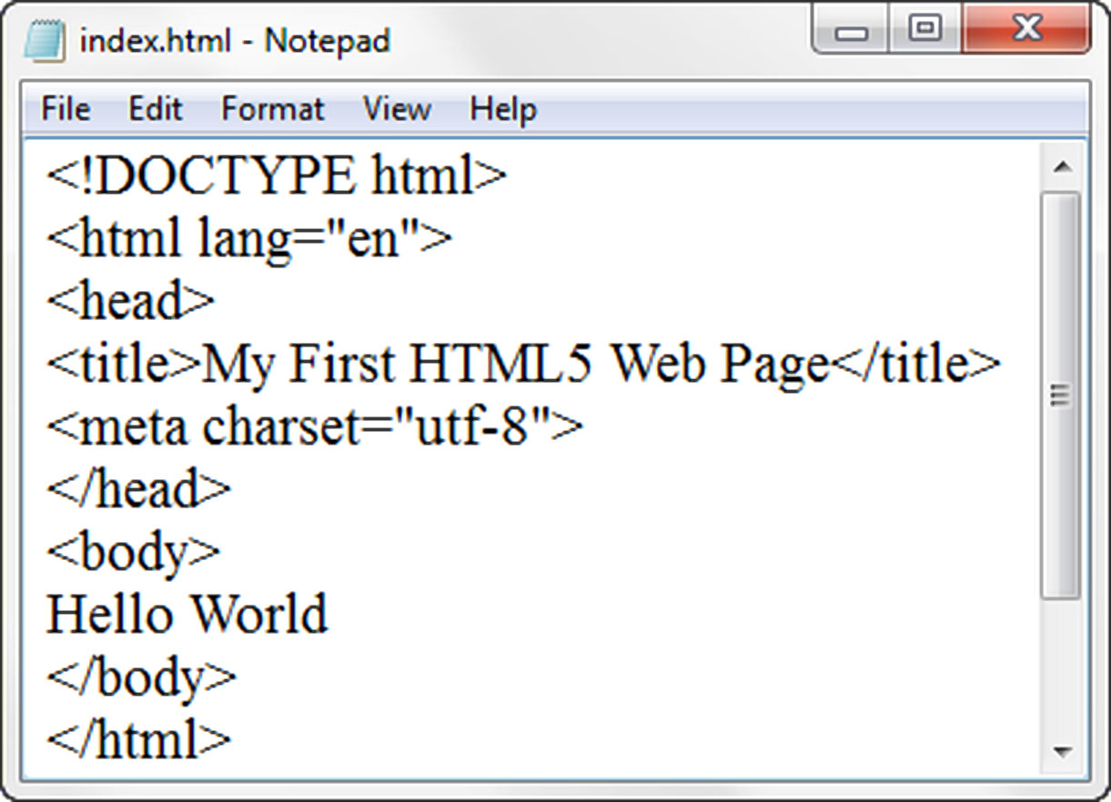
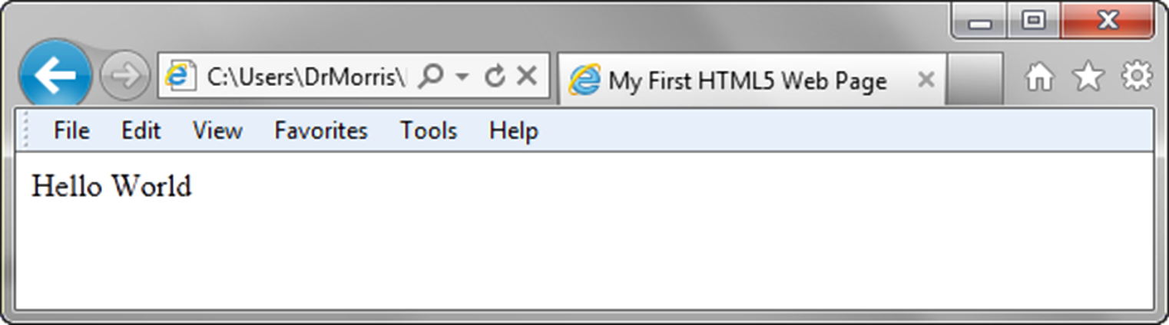
TITLE ELEMENT
META ELEMENT
Notes:
Chapter 2

Slide 11
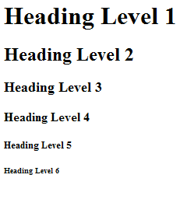
HEADING ELEMENT
<h1>Heading Level 1</h1>
<h2>Heading Level 2</h2>
<h3>Heading Level 3</h3>
<h4>Heading Level 4</h4>
<h5>Heading Level 5</h5>
<h6>Heading Level 6</h6>
Notes:
Chapter 2

Slide 12
PARAGRAPH ELEMENT
Paragraph element
<p> …paragraph goes here… </p>
  Groups sentences and sections of text together.
  Block Display – Configures empty space above and below
Notes:
Chapter 2

Slide 13
LINE BREAK ELEMENT
Line Break element
  Stand-alone, or void tag
  …text goes here <br>
  This starts on a new line….
  Causes the next element or text to display on a new line
Notes:
Chapter 2

Slide 14
BLOCKQUOTE ELEMENT
Blockquote element
  Indents a block of text for special emphasis
  <blockquote>
  …text goes here…
  </blockquote>
  Block Display – Configures empty space above and below
Notes:
Chapter 2

Slide 15
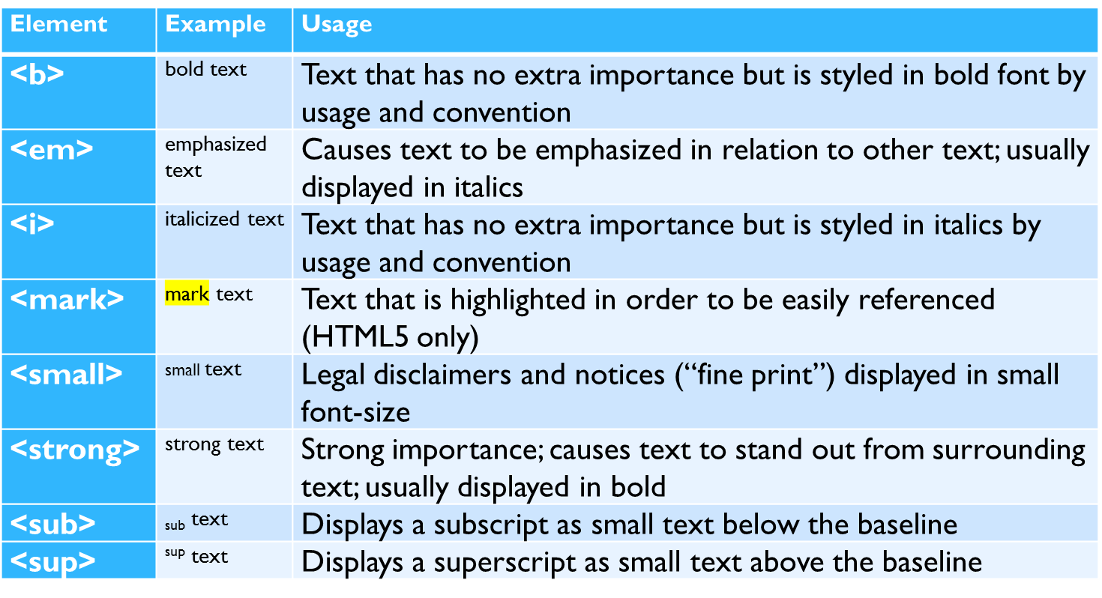
PHRASE ELEMENTS
Indicate the context and meaning of the text
Notes:
Chapter 2

Slide 16
PROPER NESTING
CODE:
<p><i>Call for a free quote for your web development needs: <strong>888.555.5555 </strong></i></p>
BROWSER DISPLAY:
Call for a free quote for your web development needs: 888.555.5555

Slide 17
HTML LISTS
Unordered List
Ordered List
Description List
formerly called a definition list
Notes:
Chapter 2

Slide 18
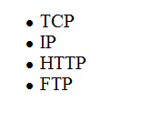
UNORDERED LIST
Displays a bullet, or list marker, before each entry in the list.
<ul>
Contains the unordered list
<li>
Contains an item in the list
Notes:
Chapter 2

Slide 19
UNORDERED LIST EXAMPLE
<ul>
<li>TCP</li>
<li>IP</li>
<li>HTTP</li>
<li>FTP</li>
</ul>
Notes:
Chapter 2

Slide 20
ORDERED LIST
Displays a numbering or lettering system to itemize the information contained in the list
<ol>
Contains the ordered list
  type attribute determines numbering scheme of list, default is numerals
<li>
Contains an item in the list
Notes:
Chapter 2

Slide 21
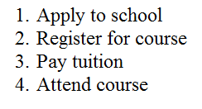
ORDERED LIST EXAMPLE
<ol>
<li>Apply to school</li>
<li>Register for course</li>
<li>Pay tuition</li>
<li>Attend course</li>
</ol>
Notes:
Chapter 2

Slide 22
DESCRIPTION LIST
Useful to display a list of terms and descriptions or a list of FAQ and answers
  <dl>
  Contains the description list
  <dt>
  Contains a term/phrase/sentence
  Configures empty space above and below the text
  <dd>
  Contains a description of the term/phrase/sentence
    Indents the text
    Configures empty space above and below the text
Notes:
Chapter 2

Slide 23
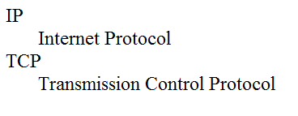
DESCRIPTION LIST EXAMPLE
<dl>
<dt>IP</dt>
<dd>Internet Protocol</dd>
<dt>TCP</dt>
<dd>Transmission Control Protocol</dd>
</dl>
Notes:
Chapter 2

Slide 24
CHECKPOINT
Describe the features of a heading element and how it configures the text.
Describe the difference between ordered lists and unordered lists.
Describe the purpose of the blockquote tag.
Notes:
Chapter 2

Slide 25
SPECIAL CHARACTERS
Display special characters such as quotes, copyright symbol, etc.
Character Code
© &copy;
< &lt;
> &gt;
& &amp;
&nbsp;
Notes:
Chapter 2

Slide 26
DIV ELEMENT
Configures a structural block area or “division” on a web page with empty space above and below.
Can contain other block display elements, including other div elements
<div>Home Services Contact</div>

Slide 27
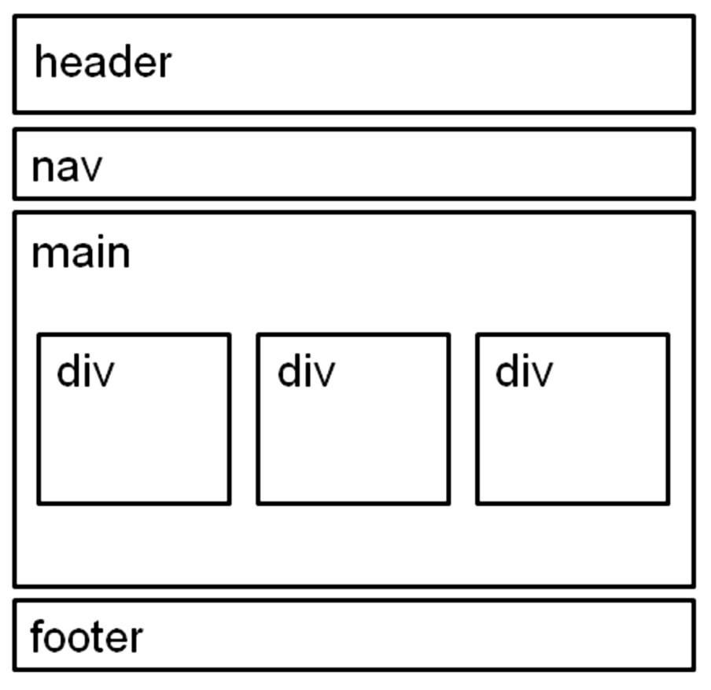
HTML5 STRUCTURAL ELEMENTS
header Element
  <header></header>
  Contains the web page
  document’s headings
nav Element
  <nav></nav>
  Contains web page
  document’s main navigation
main Element
<main></main>
Contains the web page
document’s main content
footer Element
  <footer></footer>
  Contains the web page
  document’s footer

Slide 28
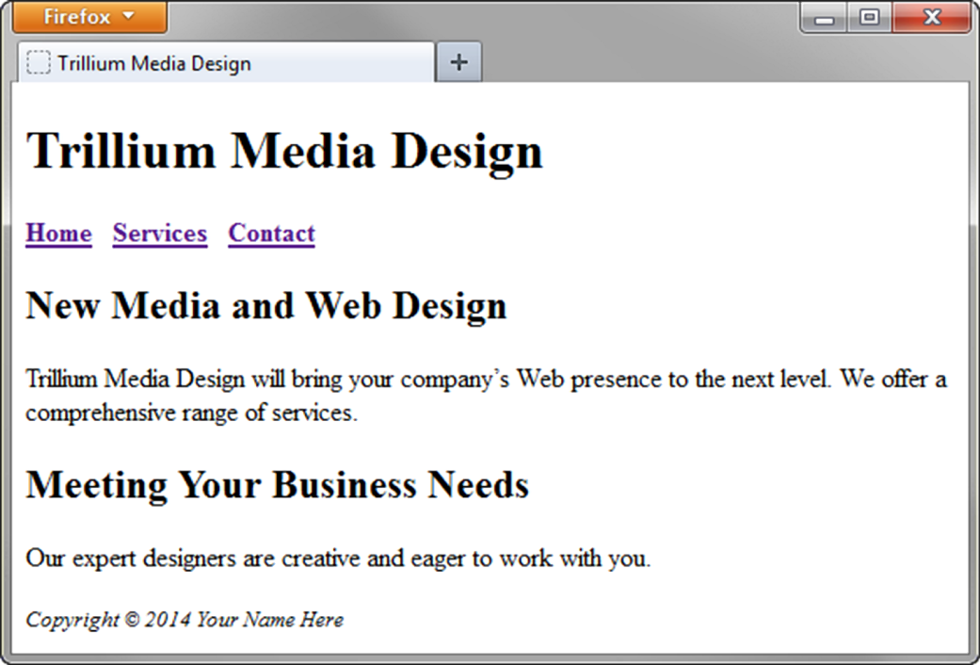
HTML5 STRUCTURAL ELEMENTS
<body>
<header> document headings go here </header>
<nav> main navigation goes here </nav>
<main> main content goes here </main>
<footer> document footer information goes here </footer>
</body>

Slide 29
ANCHOR ELEMENT
Specifies a hyperlink reference (href) to a file
Text between the <a> and </a> is displayed on the web page.
<a href="contact.html">Contact Us</a>
href Attribute
  Indicates the file name or URL
Notes:
Chapter 2

Slide 30
ABSOLUTE & RELATIVE HYPERLINKS
Absolute link
  Link to a different website
<a href="http://yahoo.com">Yahoo</a>
Relative link
  Link to pages on your own site
<a href="index.htm">Home</a>
Notes:
Chapter 2

Slide 31
E-MAIL HYPERLINK
Automatically launch the default mail program configured for the browser
If no browser default is configured, a message is displayed
<a href=“mailto:me@gmail.com”>me@gmail.com</a>
Notes:
Chapter 2

Slide 32
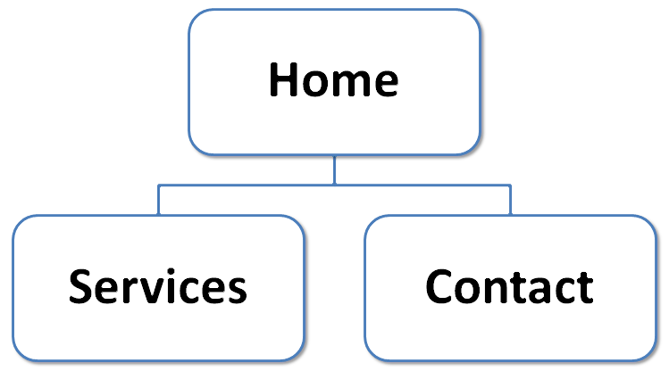
HYPERLINKS
Hands-On Practice
Notes:
Chapter 2

Slide 33
CHECKPOINT
Describe the purpose of special characters.
Describe when to use an absolute link.
Is the http protocol used in the href value?
Describe when to use a relative link. Is the http protocol used in the href value?
Notes:
Chapter 2

Slide 34
WRITING VALID XHTML
Check your code for syntax errors
  Benefit:
    Valid code →
    more consistent browser display
W3C HTML Validation Tool
  http://validator.w3.org
Notes:
Chapter 2

Slide 35
SUMMARY
This chapter introduced you to HTML.
You will use these skills over and over again as you create web pages.
Notes:
Chapter 2

